Slide 1
Tech-Aided Education

Slide 2
The Promises of Tech-Aided Education
The tech-aided classroom will provide the motivation and prevent the student from getting bored (Kearsley, 64).
The tech-aided classroom will allow individuals with learning disabilities to get the individualized education they require (Kearsley, 72).
The effectiveness of the education is dependent upon the instructor’s skill of teaching with tech (Kearsley, 85).

Slide 3
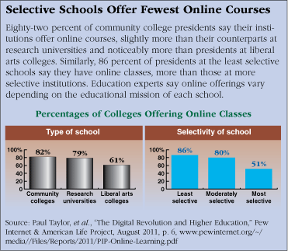
The Realities of Tech-Aided Education Today
There is a relationship between the use of online learning and the prestige of an institution.
Tech in education is inconsistent between teachers at the same institution (Selwyn, 25)... many teachers are inept at tech.
The only constant form of tech use in school are word processors, powerpoint presentations, and the use of search engines.

Slide 4
The Future of Tech-Aided Education
We are currently seeing a rise in the flipped classroom, where content is consumed at home, and then discussed or practiced in class (Khan). This is the way many classes (languages in specific) are taught at UNC.
Gamification of instruction with the use of video game.

Slide 5
The Cons of Digital Flipped Classroom Model
During lecture/home study, student cannot ask for help on a specific example and receive immediate feedback.
It assumes access to high-speed internet is available, with very few legislators who are willing to subsidize the costs of providing access to all (Selwyn, 56).
The need for more, faster computers are increasing higher than the rate that they can be provided (Project Tomorrow).

Slide 6
The Pros of Digital Flipped Classroom Model
It allows for a more equalized lecture, in which the student can go through the content as fast or slow as they need (Seale, 25).
Offers multimedia and interactivity (Belskie).
Teachers can spot gaps in knowledge quickly through technologies like Khan Academy (Thompson, 182)

Slide 7
Gamification
The use of video games as an educational tool is no new idea.
Video games not only offer interactivity but rewards (Belskie).
Video games offer a certain framework (i.e. simulation), unlike most educational software.
Many video games offer some sort of customization/designer abilities.

Slide 8
Are Video Games the Future of Education?
No.
However, certain aspects of video games are likely to be seen in educational software:
Rewards
Interactivity
Framework
Design elements -- have students design their own “game” with educational elements.

Slide 9
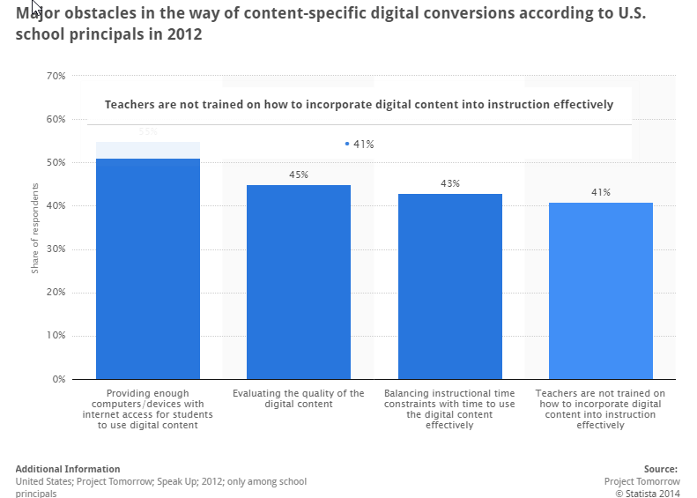
Obstacles to classroom conversion

Slide 10
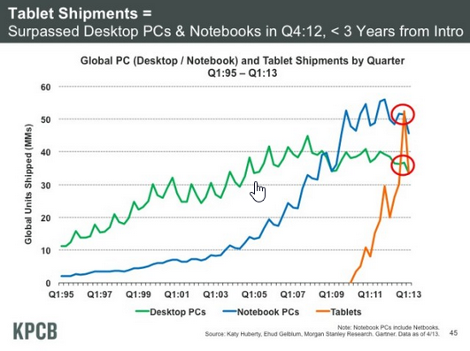
Providing enough computers/devices with internet access
Growth of tablets will make flipped classroom possible
cheap
mobile
interactive

Slide 11
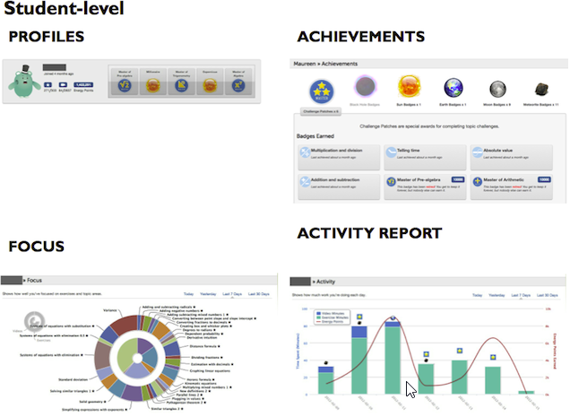
Evaluating the quality of digital content
Khan Academy - tracks progress for teachers, pattern recognition, even more features can be easily added
Pair this with in class activities and quizzes

Slide 12
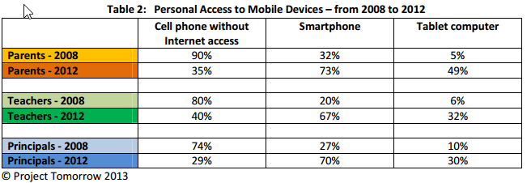
Teachers not trained on how to best use technology in class
Only way this will change is through tech being used in class

Slide 13
Sources

